Slide 1

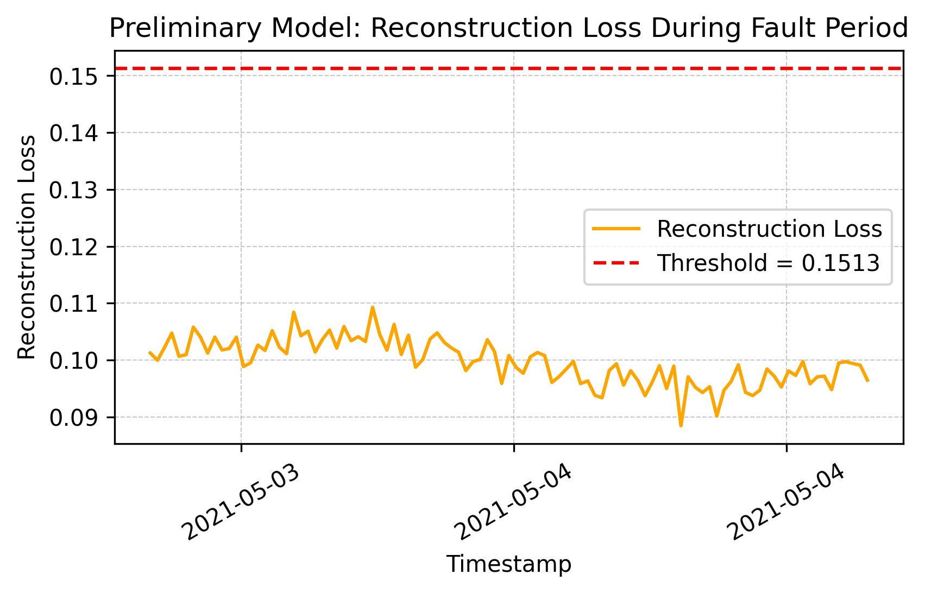
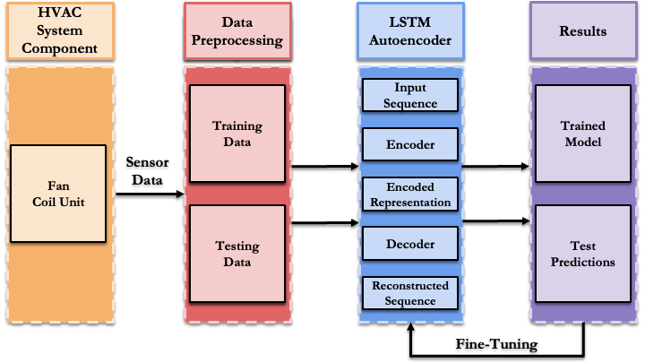
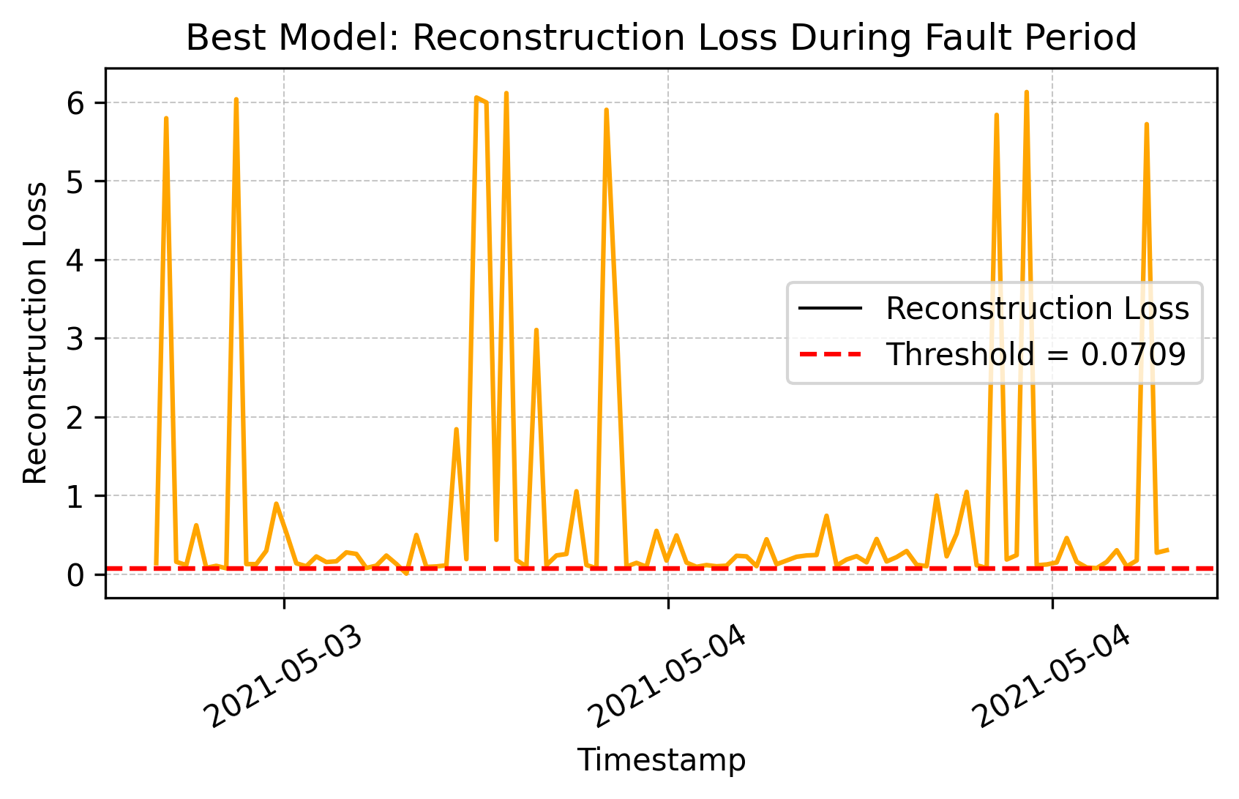
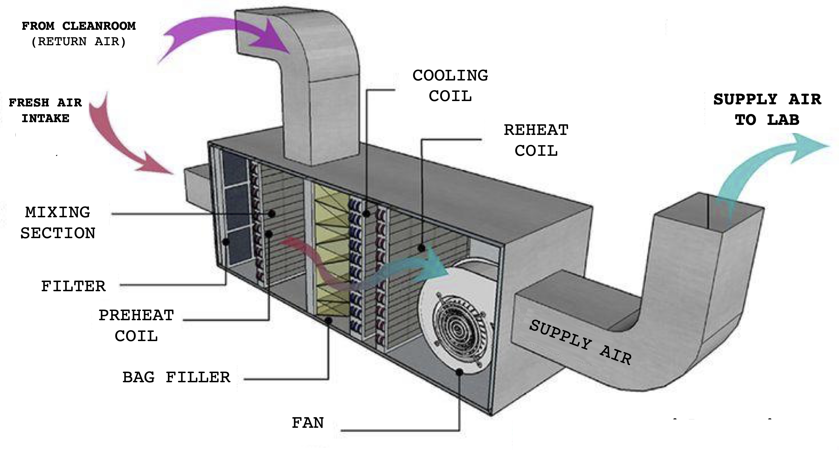
25-610
Smart Buildings: Sustainability and Efficiency
Team members: Daniel Gubay, Esha Sharma, Jaime Gerardo Juarez, Grant Forest-Collins | Faculty advisers: Daniel Cranston Ph.D., Joao Soares Ph.D.
Sponsor: Siemens | Mentors: Kenneth Cossaboon, Byron Burns
Understanding The Problem
Model Architecture
Preliminary vs. Best Model
Siemens provides HVAC equipment like sensors, valves, and actuators for VCU buildings.
Feature data includes valve positions, temperature readings, occupancy status, and engineered time indicators (day, hour, season).
Breakdowns in HVAC systems are fixed after they occur, which can cause delays and increase costs.
The training data contains normal behavior, while abnormal patterns are set aside for the testing data.
Solution: Predictive Maintenance
Data is normalized and encoded for consistent model input.
Our predictive maintenance model will:
Use operational data of a fan coil unit (FCU) in a VCU COE West Hall lab
Figure 3. Preliminary Model: Reconstruction Loss
Prevent unexpected breakdowns of the FCU through fault detection
Figure 2. Model Architecture Overview
Figure 4. Best Model: Reconstruction Loss
The LSTM Autoencoder learns to reconstruct normal behavior. When it cannot, reconstruction loss increases.
Conclusions
Figure 1. Fan Coil Unit Schematic
Source: https://thefurnaceoutlet.com
Faults are detected when test reconstruction loss exceeds the anomaly threshold.
The model performs well on purely normal or purely faulty datasets but struggles to distinguish faults in mixed datasets. This suggests that sensitivity to faults in near-normal conditions needs to be improved.
Notes:
Ahmed, O. (1996). Model-based control of laboratory HVAC systems.

